Slide 1
Preterm Birth Prediction
http://www.synapse.org/pretermbirth
Chaojie Zhang

Slide 2
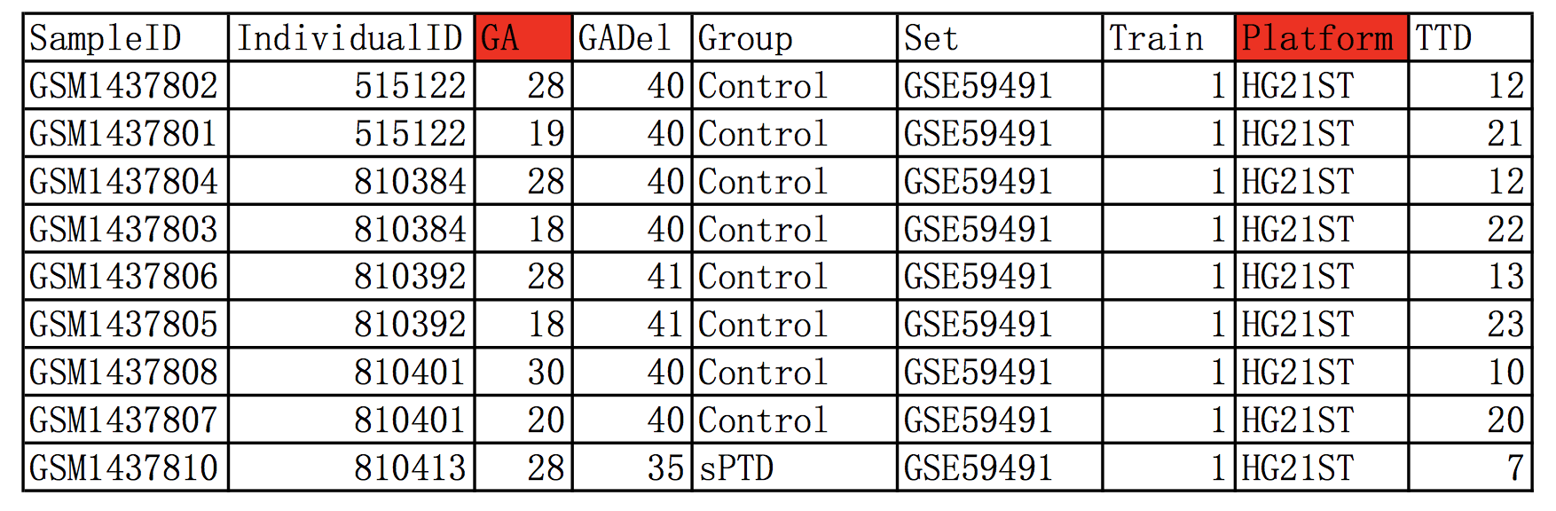
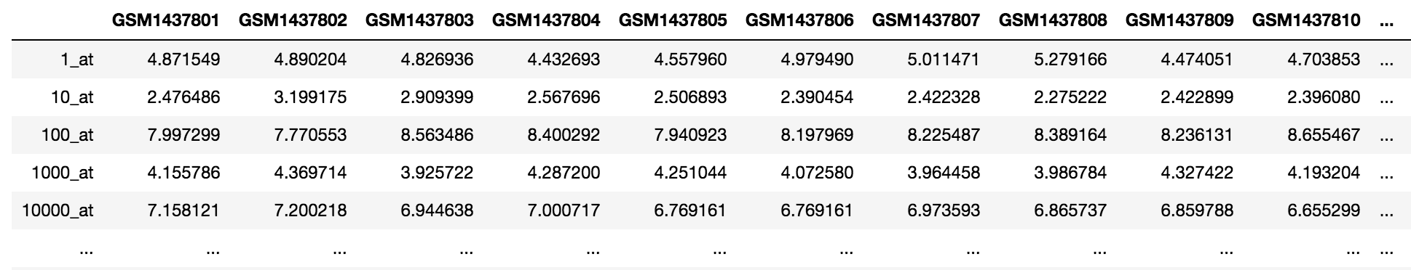
Data
The training dataset includes microarray data for 2 or more samples from 196 women (435 samples total) in two different platforms.
GA: gestational age as determined by the last menstrual period and or ultrasound;
Platform: gene expression platform used to generate the cell files.

Slide 3
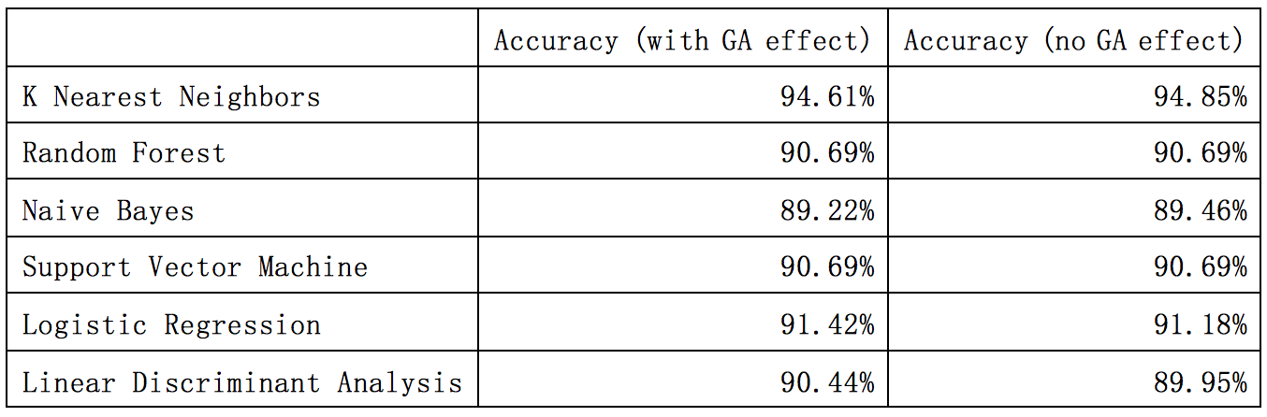
Data Normalization and GA Effect
Package in R: preprocessCore, limma
Methods Applied
Use all genes for prediction.
Randomly split the data into two groups, 80% training set and 20% test set. Repeat 8 times to get the prediction accuracy.

Slide 4
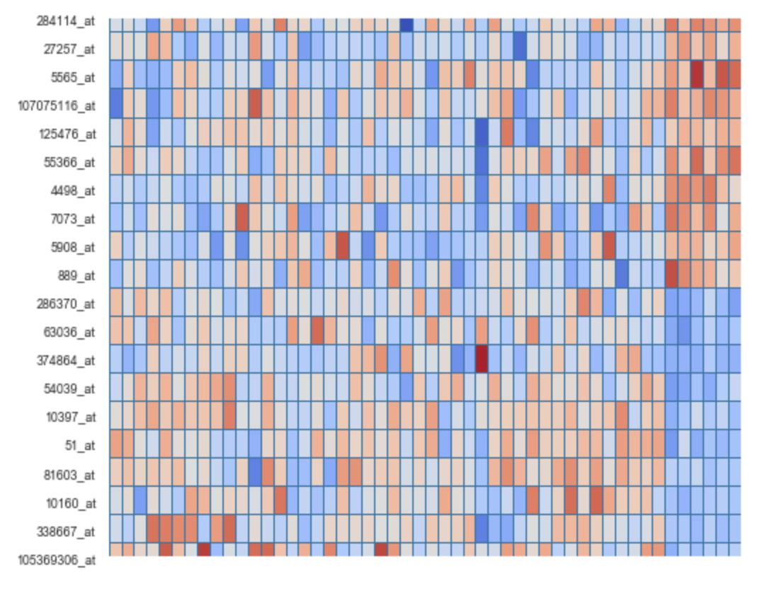
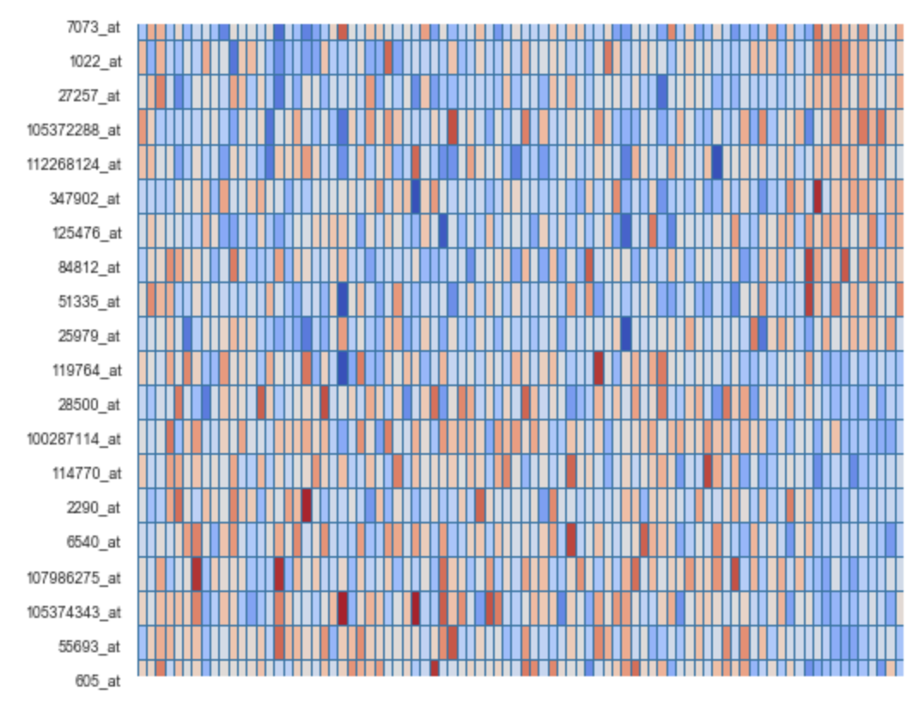
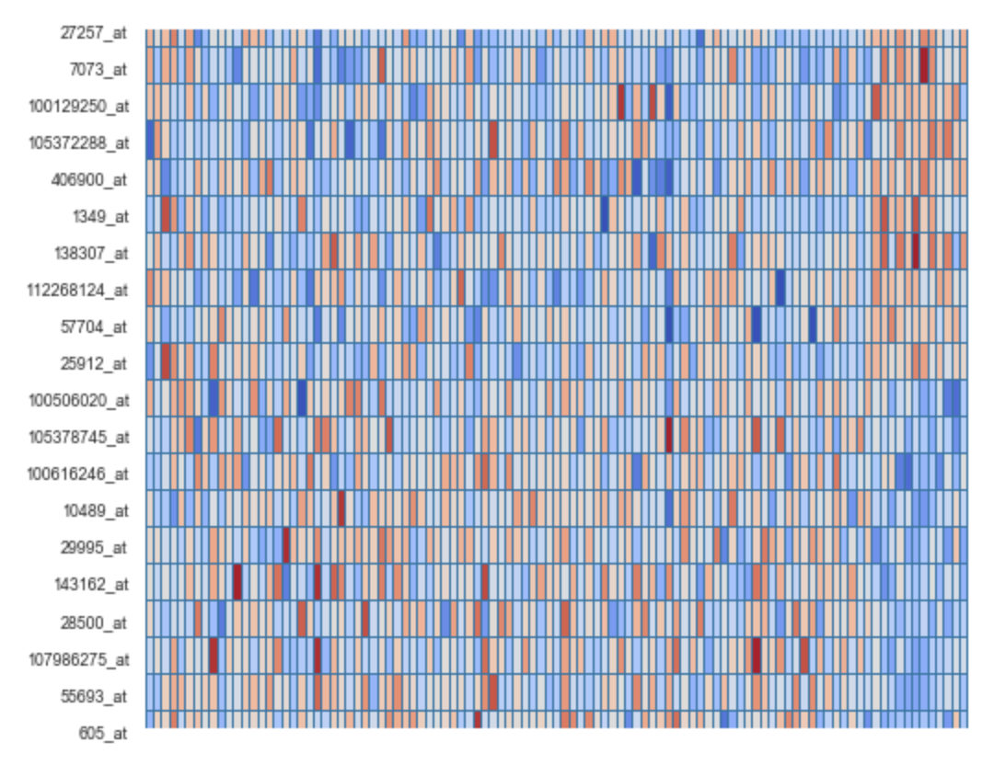
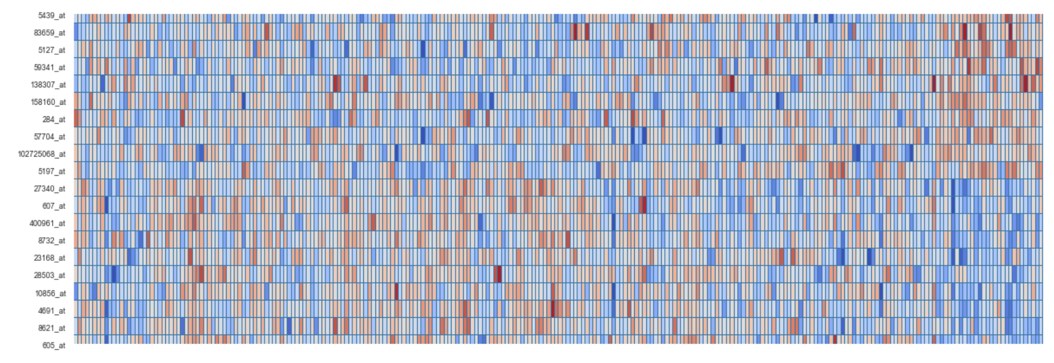
GA Effect
GA=19
GA=19~20
GA=19~23
ALL GA

Slide 5
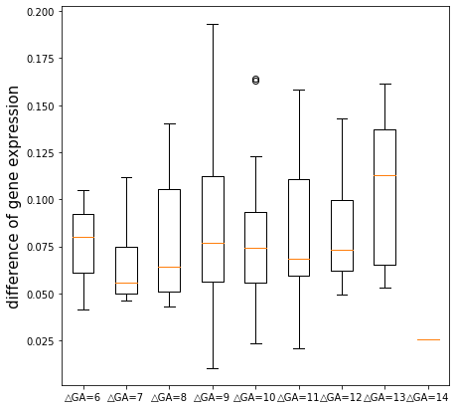
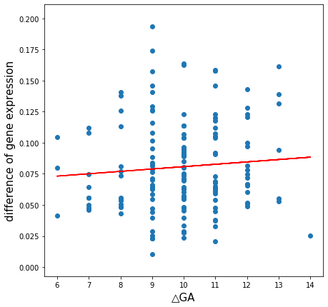
GA Effect
Select genes with high t-test score in different gestational age.
There are samples from same person in different gestational age, these information can be used to see the GA effect of different samples.

Slide 6
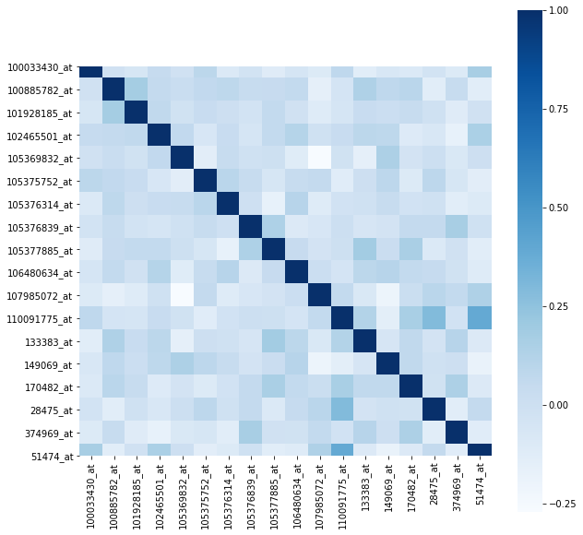
Correlation Maxtrix

Slide 7
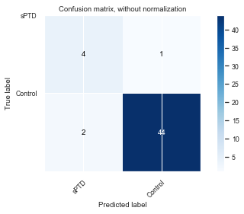
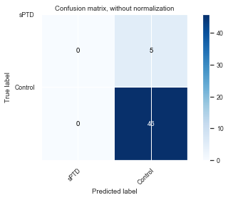

Confusion Maxtrix
K-nearest Neighbors Random Forest Naive Bayes
Support Vector Machine Logistic Regression Linear Discriminant Analysis

Slide 8
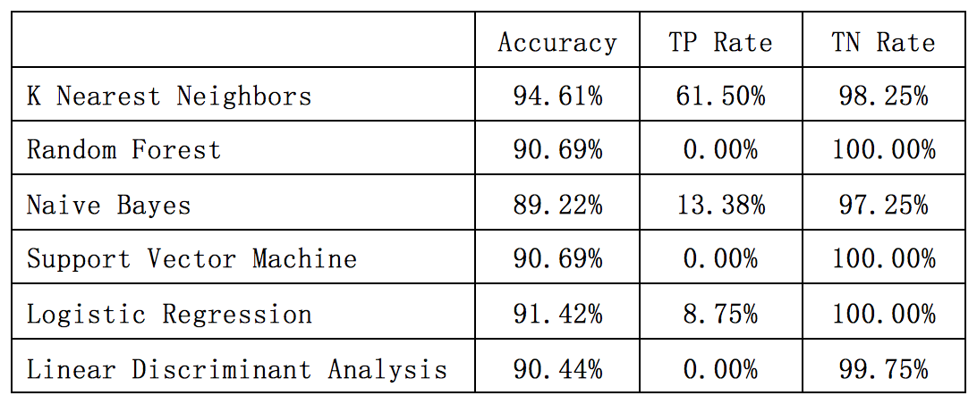
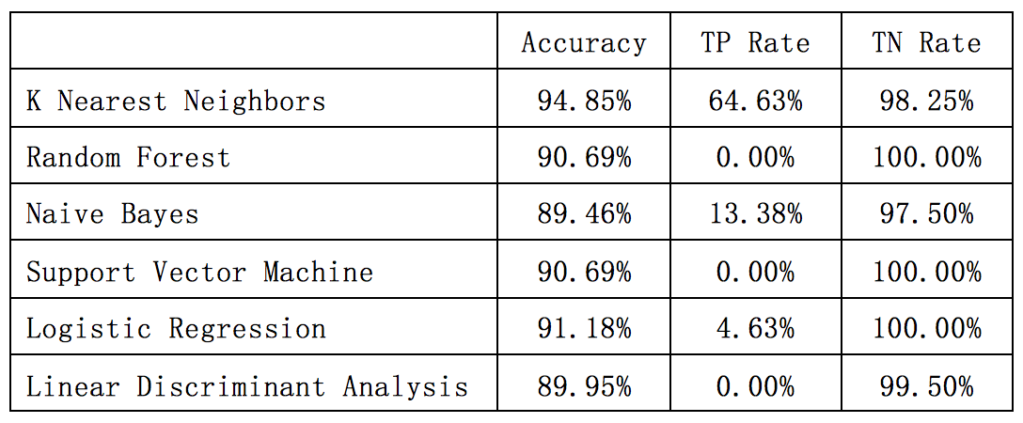
With GA Effect
No GA Effect

Slide 9
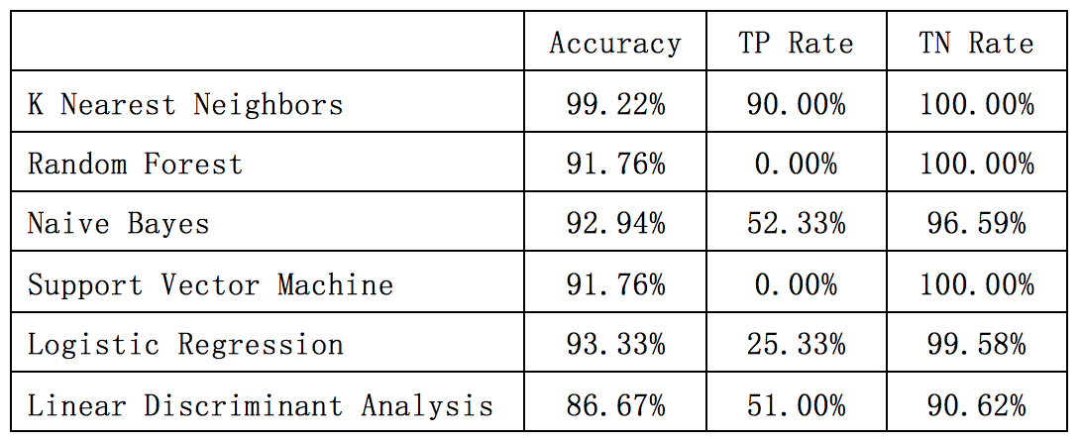
Feature Selection
Preliminary selection: select features of high t-test score in different GA, about 300 genes are selected from 30000 genes.
All genes
Selected genes

Slide 10
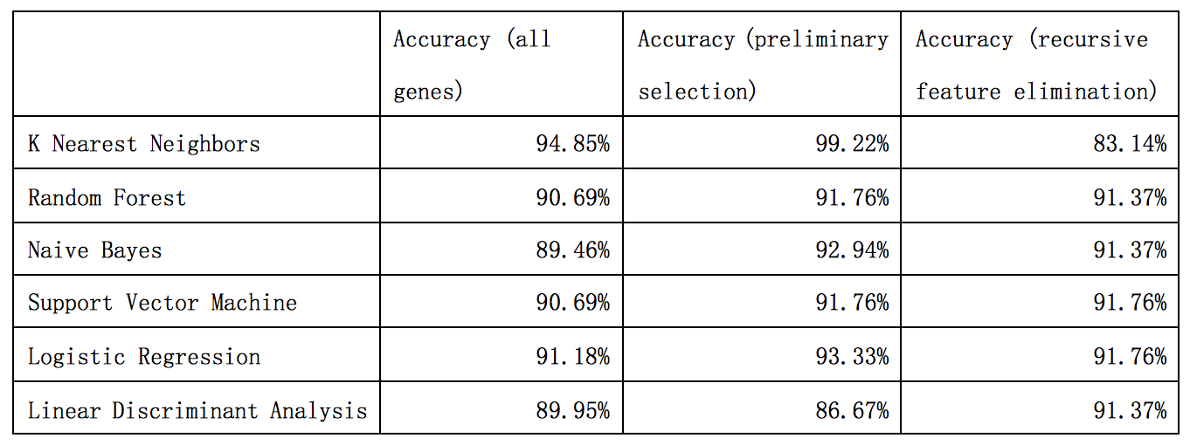
Feature Selection
Apply recursive feature elimination method to select the best genes for prediction.

Slide 11
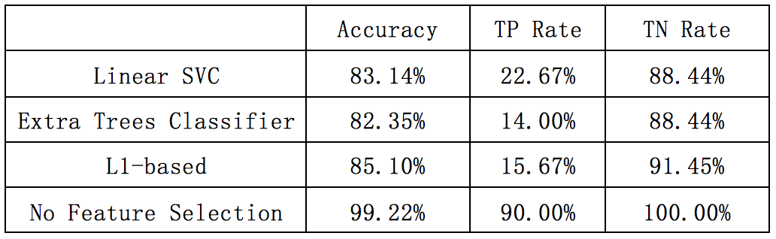
Feature Selection in KNN
The feature selection methods fail to give a better prediction.
New Feature Selection Algorithm in KNN
Randomly choose the features each time, then repeat multiple times to get the best features. But it takes a very long time to run.

Slide 12
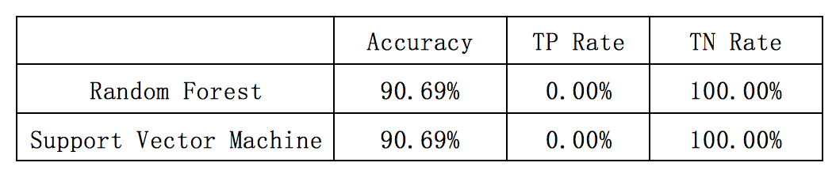
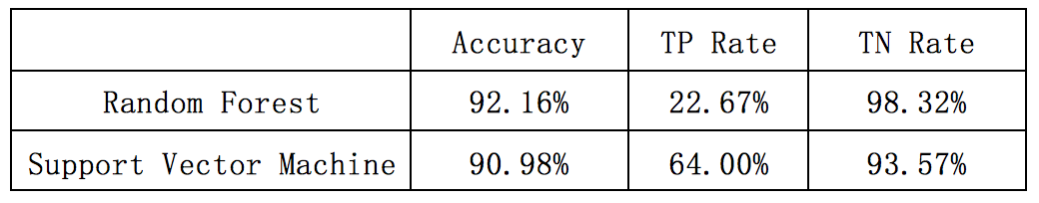
Resampling
Random Forest and Support Vector Machine give very low True Positive Rate in previous prediction. Resampling can help increase the True Positive Rate.
Original sampling
Resampling

Slide 13
Thank you!

